Slide 1
Graphs
What is a graph?
Formally: A set of vertices and a set of edges (edge = pair of vertices)
Intuitively: Representation of relationships among objects
V stands for either the set of all vertices or the number of vertices
E stands for either the set of all edges or the number of edges
V = {1, 2, 3, 4, 5, 6, 7}
E = {(1,2), (1,4), (2,3), (2,4), (3,4),
(3,5), (4,5), (4.7), (5,7)}
V = 7
E = 9
For all graphs, E is O(V²)
1
2
3
4
5
6
7

Slide 2
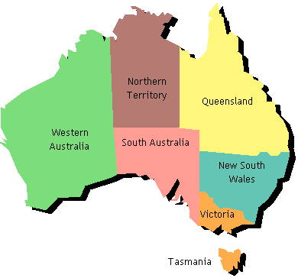
Uses for Graphs
Represent: “Borders” relation from map
Type of graph: Undirected
1
2
3
4
5
6
7

Slide 3
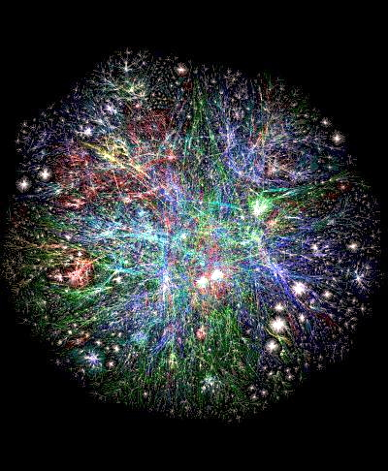
Uses for Graphs
Represent: “Linked to” relation from web pages
Type of graph: Directed
1
2
4
3
5
6
7
Visualization of WWW by G. Laugehead

Slide 4
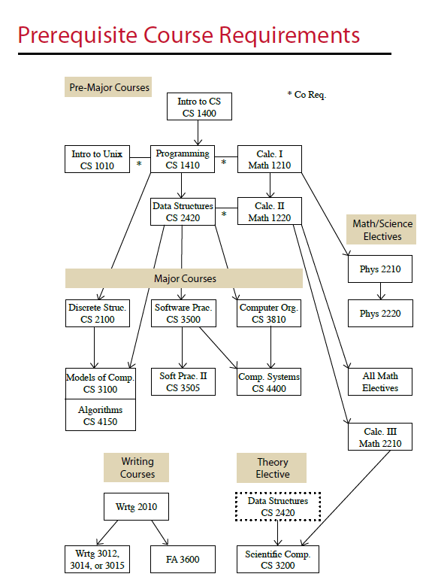
Uses for Graphs
Represent: “Prerequisite of” relationship from course catalog
Type of graph: Directed acyclic
1
2
3
4
5
6
7
8
9

Slide 5
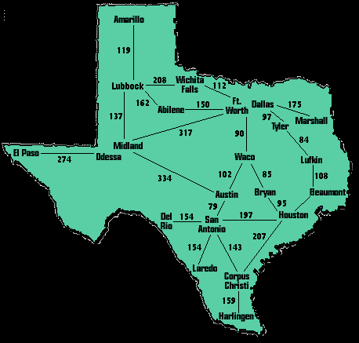
Uses for Graphs
Represent: “Distance between” cities via major roads
Type of graph: Weighted, undirected
1
90
2
102
85
5
3
79
95
4
197
6
143
207
7

Slide 6
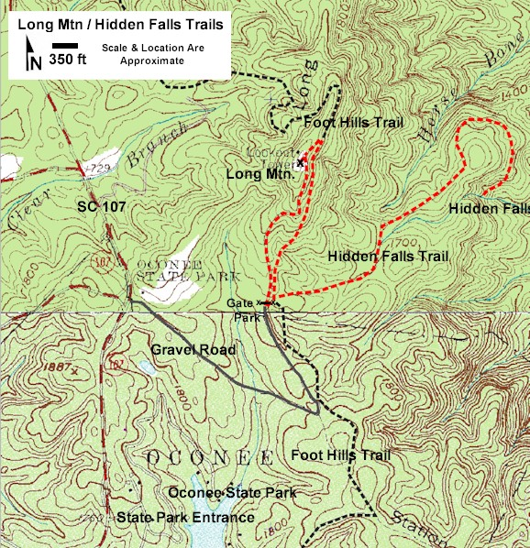
Uses for Graphs
Represent: “Time to hike” between trail intersections
Type of graph: Weighted, directed
1
45
65
2
55
20
3
4
40

Slide 7
Adjacency Matrix
Adjacency matrix stores information about each possible edge.
Consumes Θ(V²) space
1
1
1
-
-
0
65
50
1
-
-
0
-
-
0
45
50
65
45
50
1
-
-
0
-
55
1
20
20
1
2
2
2
-
-
0
55
55
1
-
-
0
-
40
20
1
55
20
55
-
-
0
-
20
1
40
40
1
-
-
0
3
3
3
4
4
4
40
40

Slide 8
Adjacency List
Adjacency list stores information about each actual edge.
Consumes Θ(E+V) space
2
2
1
1
1
2
2
2
3
2
1
2
1
1
2
/
65
50
45
50
55
55
40
20
50
/
45
65
/
/
/
3
4
3
2
2
2
4
3
3
/
4
/
20
55
20
55
20
40
55
40
4
/
/
/
3
/
3
3
4
4
4
4
40
40
20
/

Slide 9
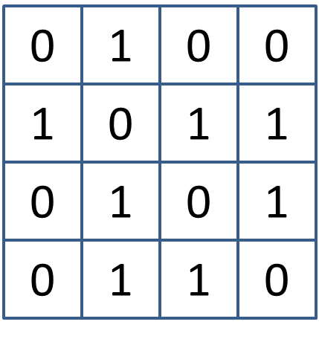
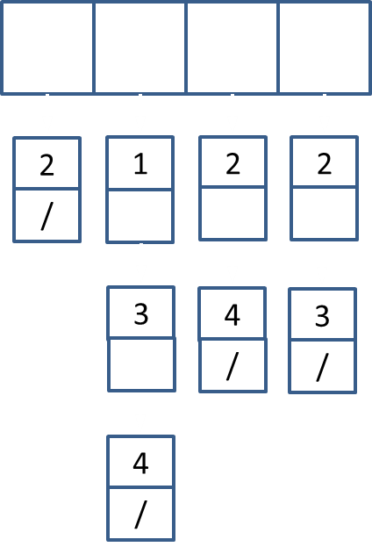
Which is Better?
A sparse graph has O(V) edges
A dense graph has Ω(V²) edges
How much space do both reps use for sparse graphs?
Matrix: Θ(V²)
List: Θ(V)
How much space do both reps use for dense graphs?
Matrix: Θ(V²)
List: Θ(V²)
But the constant is much higher for lists, especially with unweighted graphs
Are most graphs dense or sparse?

Slide 10
Simple Operations
Is there an edge from u to v?
Matrix: Θ(1)
List: O(V), O(E), and Ω(1)
Is there an edge out of u?
Matrix: O(V) and Ω(1)
List: Θ(1)
What are all the edges out of u?
Matrix: Θ(V)
List: O(V), O(E), and Ω(1)
What are all the edges?
Matrix: Θ(V²)
List: Θ(V+E)

Slide 11
Exploring From a Vertex
Systematically visit each vertex that’s reachable from a given vertex v
A
F
explore (G, v)
visited[v] = true
previsit(v)
for each (v,u) in E
if !visited[u]
explore(G, u)
postvisit(v)
B
D
G
C
E
Yellow edges are “tree edges”
White edges are “back edges”
Note: visited is a boolean-valued array indexed by vertex. Initially, every entry is false.
We animate explore(A). When there is an arbitrary choice of which vertex comes next, we go in alphabetical order. When a vertex becomes visited, it is shaded.

Slide 12
Depth-First Search
Systematically visit each vertex in a graph
dfs (G)
for each v in V
visited[v] = false
for each v in V
if !visited[v]
explore(G, v)
A
F
B
D
G
C
E
explore (G, v)
visited[v] = true
previsit(v)
for each (v,u) in E
if !visited[u]
explore(G, u)
postvisit(v)

Slide 13
Connected Components
Identify the largest connected “clumps” that make up the graph
dfs (G)
cc = 1
for each v in V
visited[v] = false
for each v in V
if !visited[v]
explore(G, v)
cc++
1
A
F
2
1
B
1
D
G
2
1
C
1
E
explore (G, v)
visited[v] = true
previsit(v)
for each (v,u) in E
if !visited[u]
explore(u)
postvisit(G, v)
previsit(v)
ccnum[v] = cc
Note: ccnum maps a vertex to the
ID number of its connected component

Slide 14
Previsit and Postvisit Orderings
Keep track of order in which vertices are visited and “completed’
dfs (G)
clock = 1
for each v in V
visited[v] = false
for each v in V
if !visited[v]
explore(G, v)
1
A
F
11
,14
,10
2
B
D
G
,9
6
,7
12
,13
,4
C
E
3
5
,8
explore (G, v)
visited[v] = true
previsit(v)
for each (v,u) in E
if !visited[u]
explore(G, u)
postvisit(v)
previsit(v)
pre[v] = clock++
postvisit(v)
post[v] = clock++

Slide 15
Analysis of Depth-First Search
O(V) [initialize visited]
O(V) [consider each vertex]
Over life of one call to dfs():
O(V) [set visited[v] V times]
O(V) [call previsit V times]
Cost of enumerating all edges
O(E) [do once per edge]
O(V) [do once per vertex]
O(V) [call postvisit V times]
Sum:
O(V) + O(E) + Enumeration
Matrix: O(V) + O(E) + O(V²) = O(V²)
List: O(V) + O(E) + O(V+E) = O(V+E)
dfs (G)
for each v in V
visited[v] = false
for each v in V
if !visited[v]
explore(G, v)
explore (G, v)
visited[v] = true
previsit(v)
for each (v,u) in E
if !visited[u]
explore(G, u)
postvisit(v)

